Slide 1


Takeoff online crowdfunding platform Developer: Sujan Shrestha (np000611) intake: np3f2304it course: Final Year Project Name of supervisor: Bishal prasad Kurmi name of 2nd marker: Rajan raj pant

Slide 2
Problem statement
Access to Funding
Promising ideas and projects face hurdles in securing necessary funds
Traditional financial mediums have stringent criteria for innovations
Visibility and Outreach
Creators struggle to gain visibility beyond their immediate surroundings
Difficulty in reaching broader audience for raising capital
Geographical Barriers
Nepal's diverse and dispersed population poses challenges for creators
Geographical constraints limit access to potential backers
Lack of Dedicated Platform
Absence of a centralized platform to connect creators with investors
Conventional funding processes lack efficiency and accessibility
Untapped Potential
Vibrant community of entrepreneurs, activists, and creative minds
Innovative ideas and projects remain unexplored due to funding constraints

Slide 3

AIM & OBJECTIVES
The primary goal of this platform is to establish an inclusive and dynamic online crowdfunding platform that fosters innovation, fuels entrepreneurship, and accelerates the growth of Nepal's creative economy bay providing creators with a dedicated space to showcase their ideas and by connecting them with interested investors, the platform aims to democratize the funding process and propel visionary concepts towards tangible success.
Empower Startups
Boost Creativity
Connect Creators and Investors
Facilitate Informed Decision-Making
Promote Economic Growth
Catalyze Social Impact
Encourage Cross-Industry Collaboration
Continuous Enhancement

Slide 4

Target users
Creators
Individuals or teams with innovative ideas or creative projects
Seek to showcase their projects on the crowdfunding platform
Aim to gain attention and funding from backers
Backers (Investors)
Potential supporters or investors interested in funding projects
Ability to browse and invest in promising ideas or ventures
Motivated by rewards, equity, or supporting innovative projects

Slide 5
Functionalities of system
Project Creation: Creators can easily launch a campaign about their project or ideas on the platform, providing comprehensive information about their project. They can also attach both images and video multimedia of their projects to grab the attention of the backers.
Investment And Payment: Investors or backers get the opportunities to browse and discover various unique projects on the platform and invest in those campaigns which they find good for the market. They can pledge a certain amount of funds towards the projects they believe in and gain different rewards according to the project.
Reward System: Creators can provide a certain range of rewards according to the pledged amounts. Investors or backers receive these rewards as a benefit for contributing towards a project when the goal amount of the project is fulfilled. Rewards can be different according to the project such as exclusive merchandise, early access to products, prototype versions of products and so on.
Updates and Feedback: In this platform, creators are encouraged to provide regular updates regarding their campaigns to keep the investors and backers informed about the progress of their project. These updates can contain different things such as milestones, future plans and so on. Also on the other hand, backers can provide campaign creators with their view and perspective about the project. This will help to maintain transparency in the campaign.
Project Analytics: Administrators have access to the more technical and comprehensive sector of the platform as they will be able to view project analytics, allowing them to track key metrics and factors such as funding progress according to categories, campaigns performance, investors engagement and so on.

Slide 6
Domain Research
According to research done by (Althoff, 2015), “many crowdfunding platforms which interact over internet allow specific kinds of projects to be funded by targeting large number of people to contribute. With critical analysis of online crowdfunding systems such as fundraiser, DonorsChoose.org and others, it is stated that the success of crowdfunding communities depends upon recruitment and continued engagement of donors. With these popular online platforms having donor attrition rate over 70%, the challenge rises due to problem of donor retention for both online and offline crowdfunding platforms.
Another research conducted by (Stiver, 2013) states that “the relationship between a crowdfunding and online community not only limits to financial terms but many non-financial benefits such as networking, collaboration, and feedback. The crowdfunding platform creates a strong community, network and pool of creators and investors whose collective efforts can have huge impact on both social and economic factors of the involved. Online exploration and advertisement with just a few clicks are one of the impactful benefits any organization or starters can get through online crowdfunding platform over the traditional offline method”.
According to the research conducted by (Stanko, 2017), “the total amount of raised during the funding campaign in crowdfunding platform does not have a significant impact on later performance of the product on the market but the total number of potential backers attracted effects the later performance of products. This output is generated by analyzing the data of crowdfunded projects from the Kickstarter website to better understand the effects of crowdfunding elements in the subsequent market”.
With objective to collect further information on the working dynamics of the crowdfunding platforms, Goran Calic and Jialiang Yang researched on the topic of “How multimedia shapes the crowdfunding outcomes” by observing 13,622 technology campaign on one of the most known crowdfunding platform “Kickstarter”. The redundant use of media can negatively impact on potential backers as the study suggests (Jialiang Yang, 2020).
Rachel E. Wheat and Jai Ranganathan describe “the dynamics of a success of a crowdfunding project depending heavily upon a successful outreach campaign. The success comes from successful outreach campaigns where the larger crowds refer to more money raised. Various online platforms such as social media platforms and advertisements can easily reach out and channel these investors directly to a proposal online. They have also stated that there is a common myth that these sorts of crowdfunding platforms are only for charismatic projects. But, according to Rachel E. Wheat and Jai Ranganathan, this assumption is completely wrong as the name of the project doesn’t attract investors, the ability or chance of the project being successful does” (E & Wheat, 2013).
According to the research done by (Bin Gu, 2019), the new technology and advancements being made in information technology will open more doors of success to platforms like online crowdfunding by enabling new business models and new market mechanisms. Online crowdfunding doesn’t only allow creators to access a place to raise funds, but it also acts as a venue for them to obtain demand information before the production and rethink their intention with the product. There is no doubt that a profit driven entrepreneur earns more than that of product driven entrepreneurs on average, as their advantages are limited by their crowdfunding platforms.

Slide 7
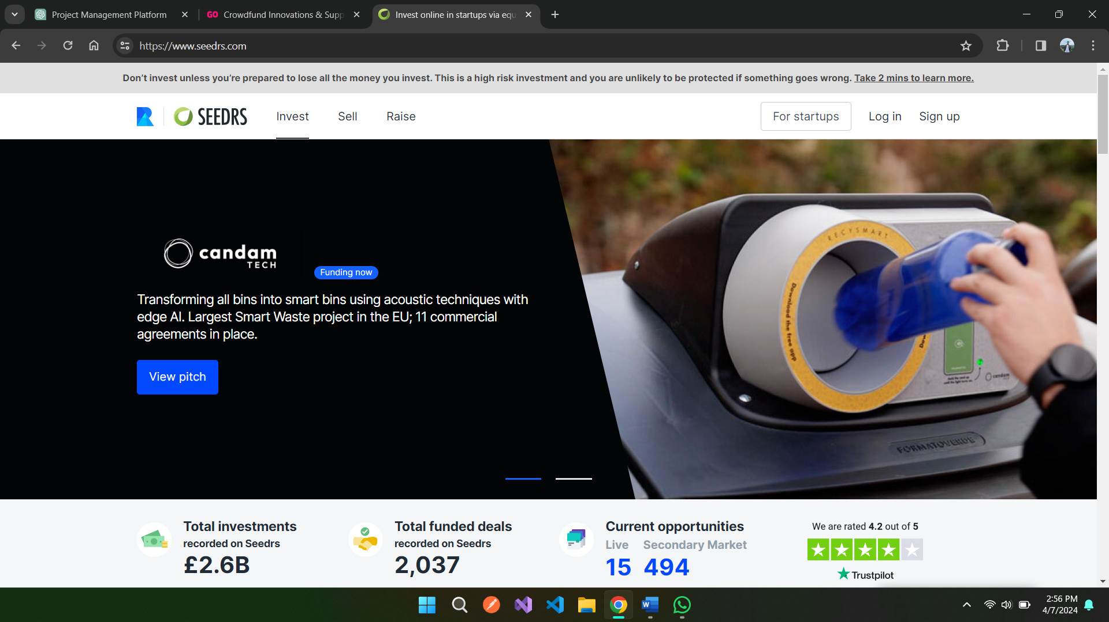
Similar Systems
Kickstarter (International Fundraising)
Indiegogo (Donations and Fundraising)
Seedrs (Stock Based Fundraising)

Slide 8
Technical Research
Selected System Development Methodology | Selected Programming languages | Database | Frameworks and other tools
Waterfall Methodology | MEAN Stack | MongoDB | Bootstrap
Sequential Process | Angular-TypeScript-HTML-SCSS | No-SQL Database | Material Angular Design
Rigidity | JavaScript-Express JS |  | ESEWA-DEMO-API-V2
 | Node JS (SERVER) |  | Chart JS

Slide 9
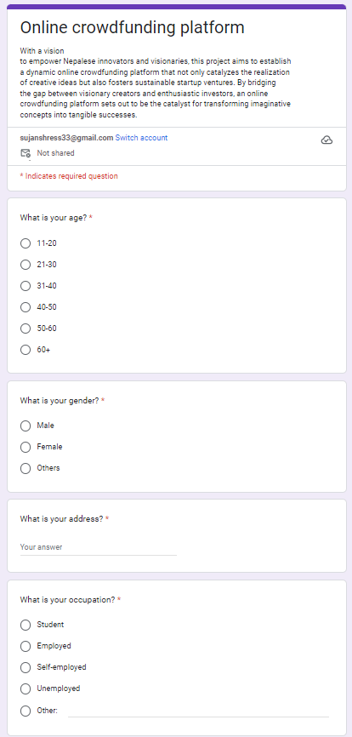
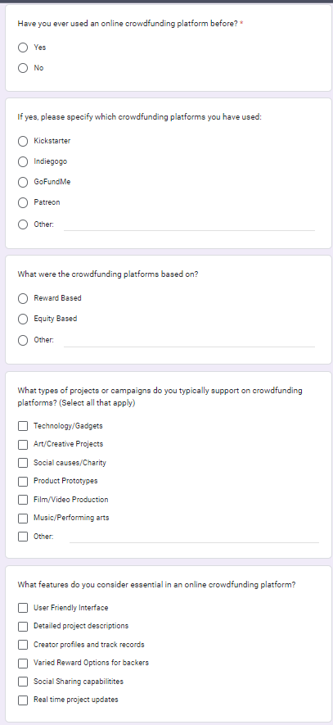
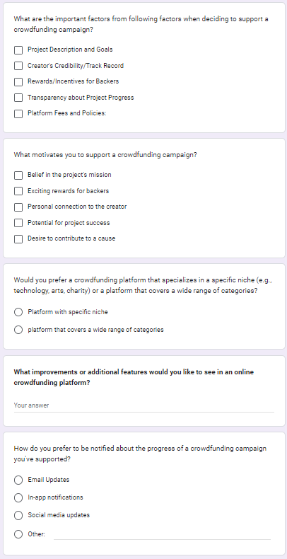
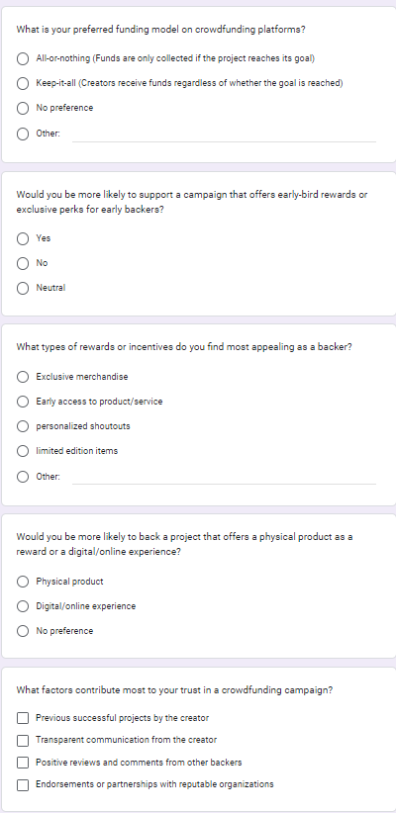
Primary Research (questionnaire)

Slide 10
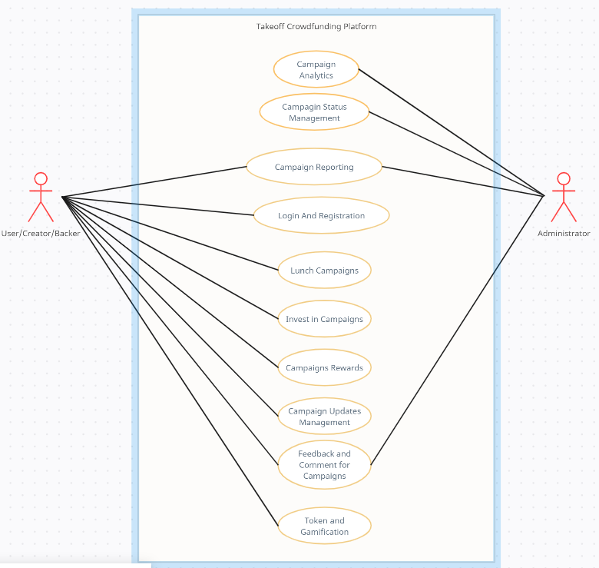
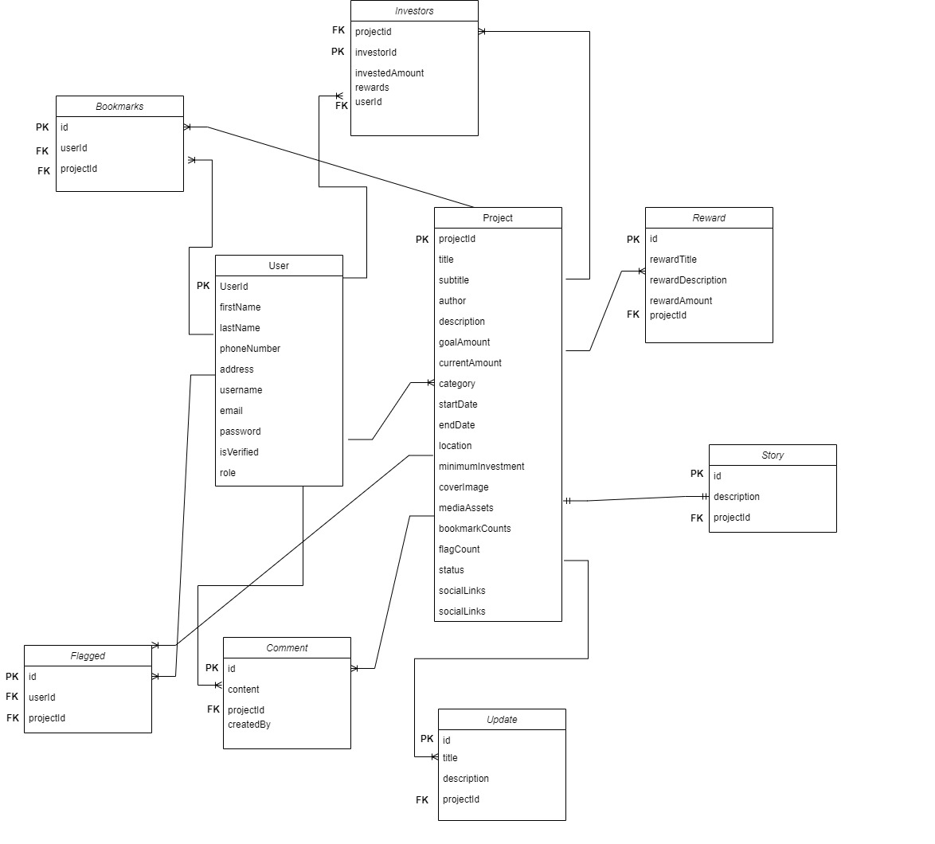
System Design
Use Case Diagram
ERD

Slide 11
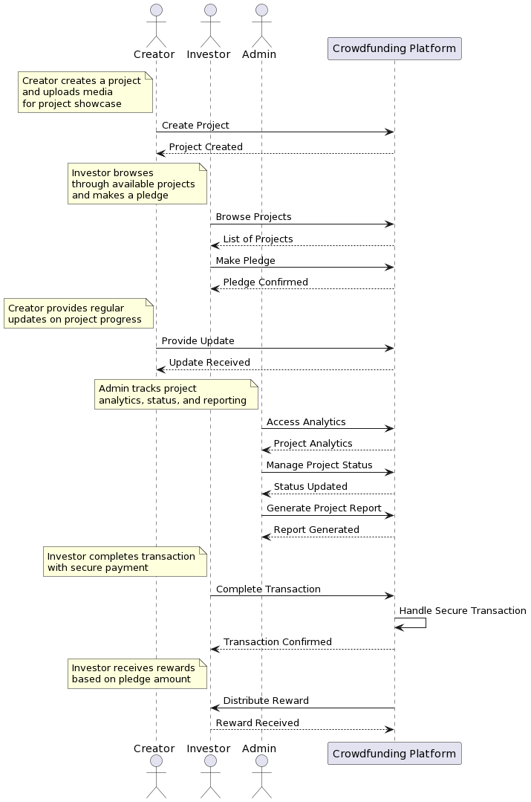
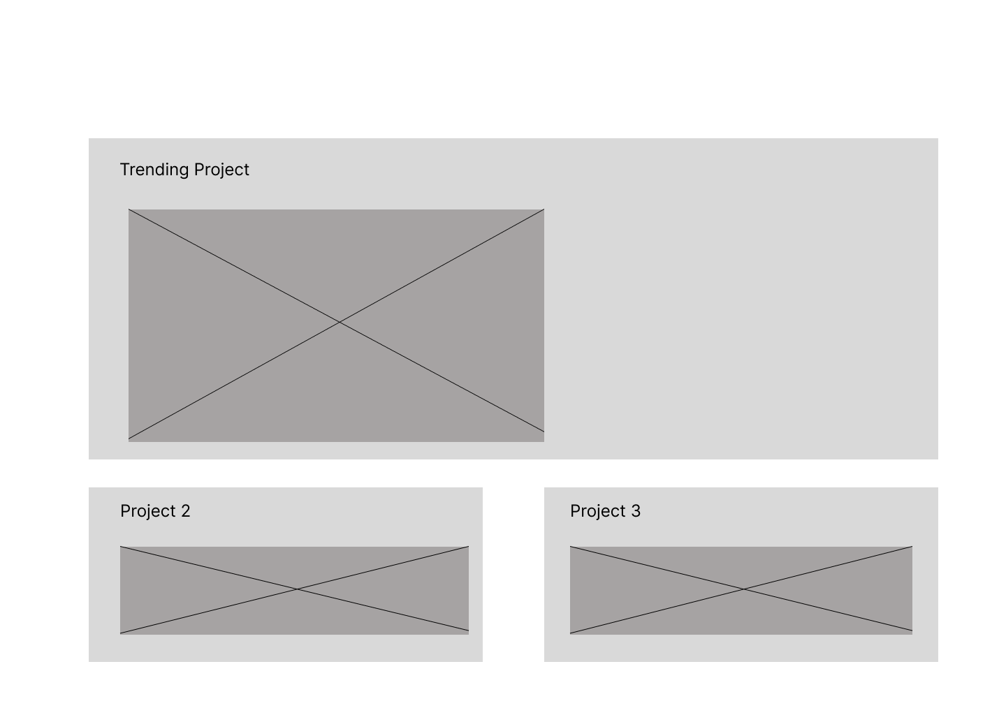
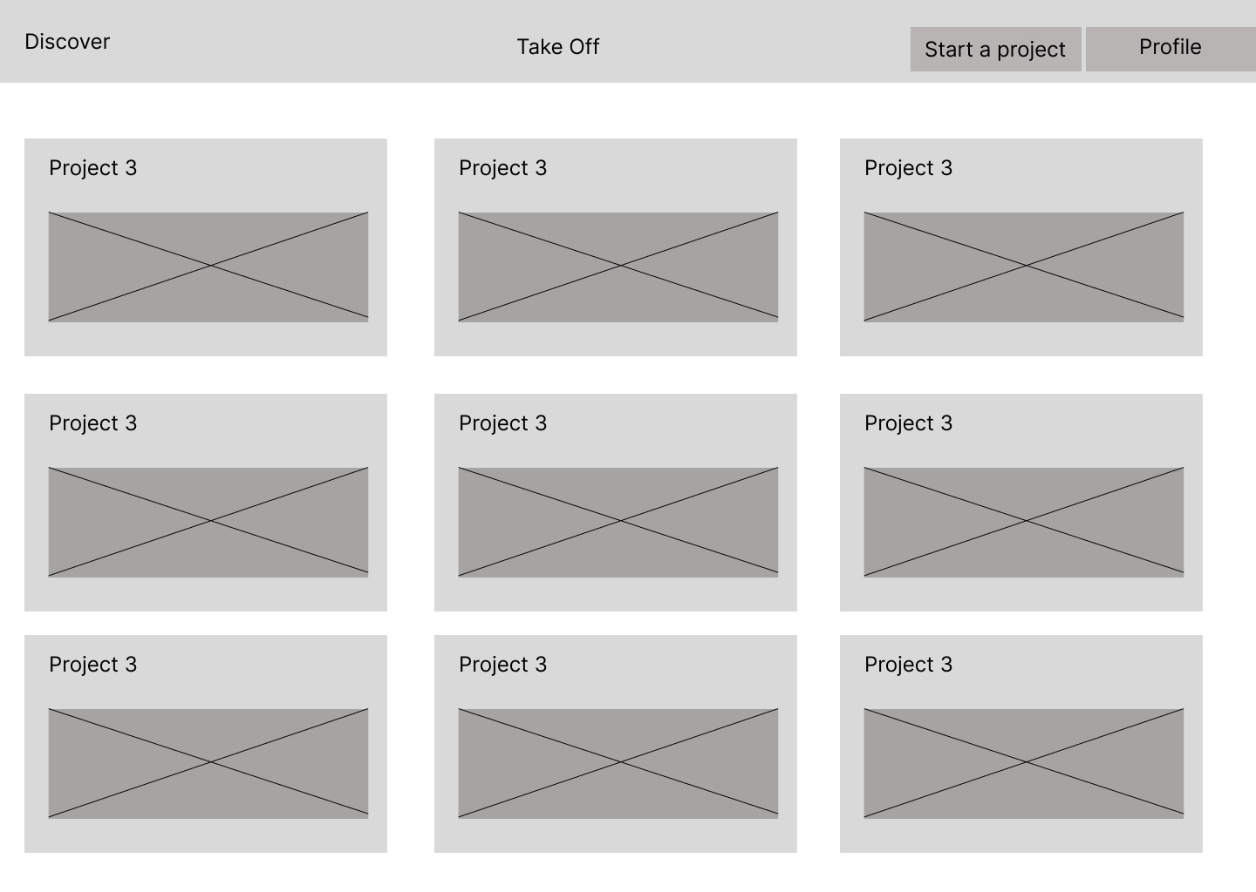
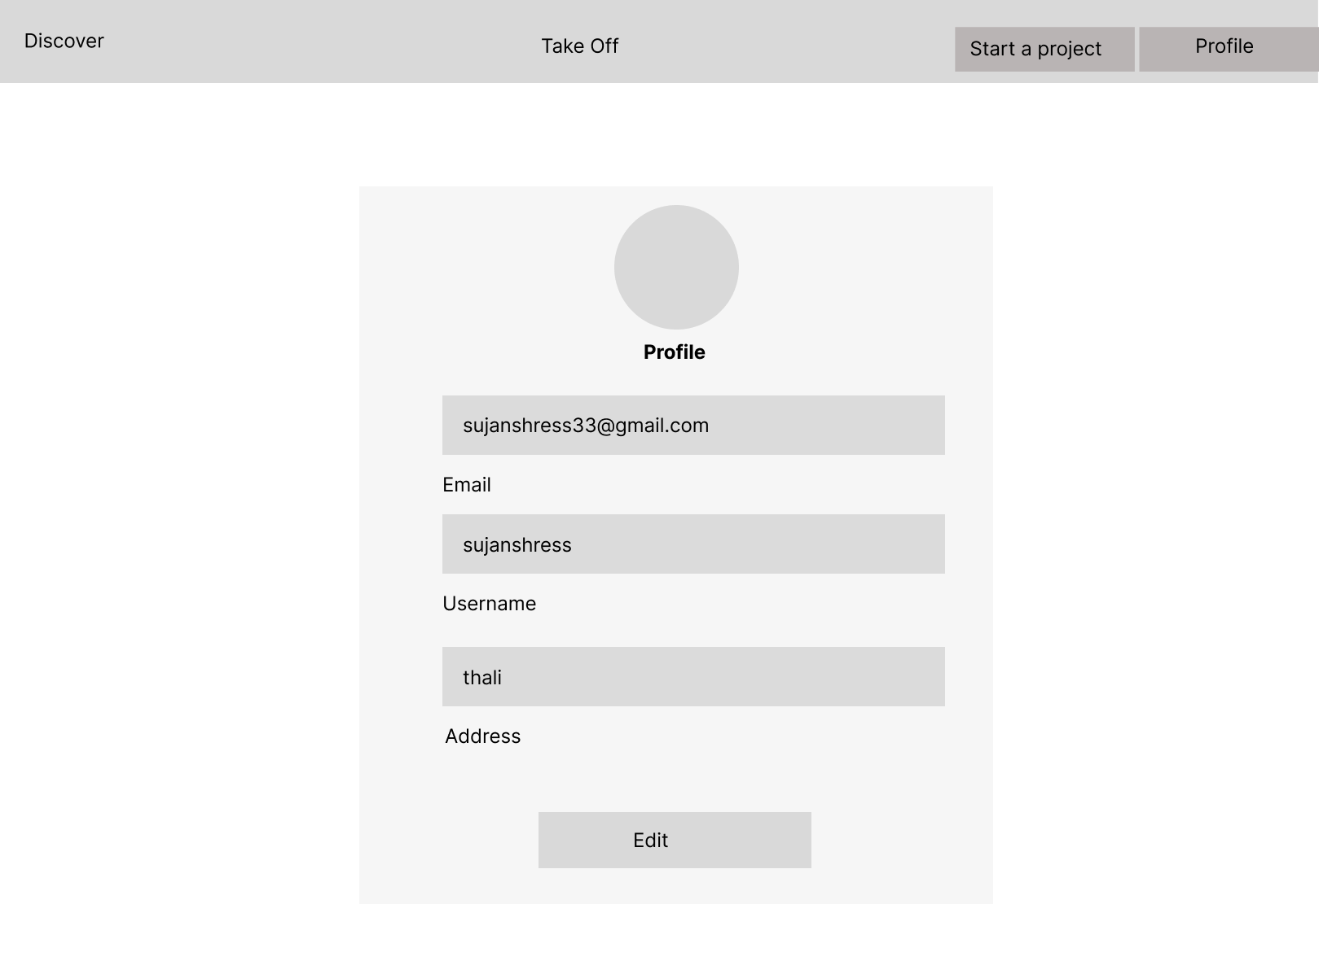
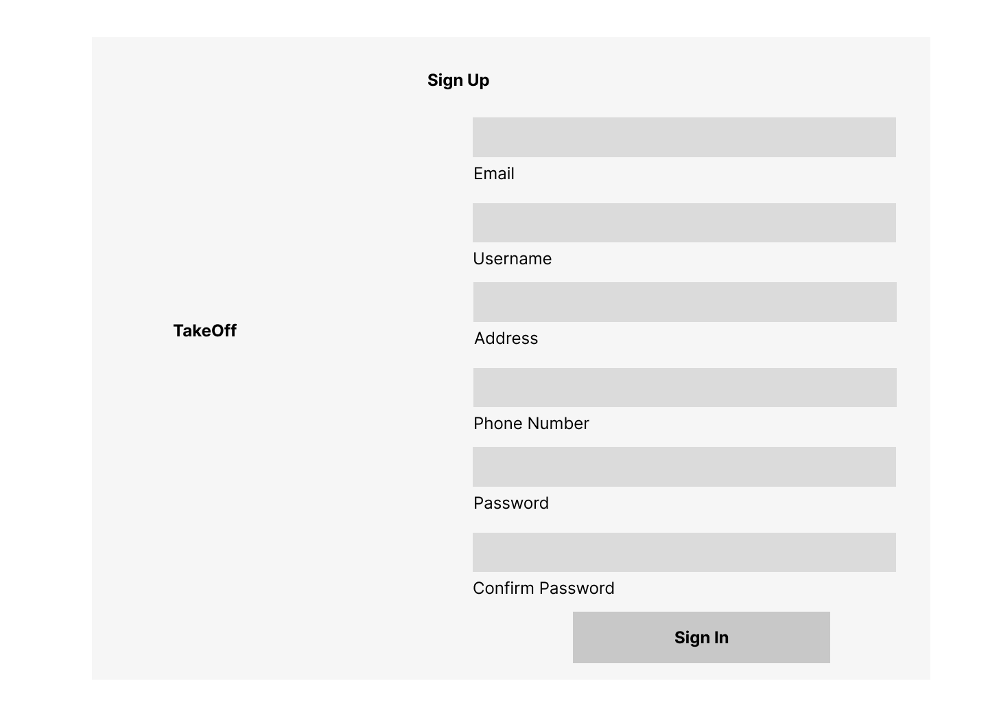
System Design
Sequence Diagram
Wireframes

Slide 12
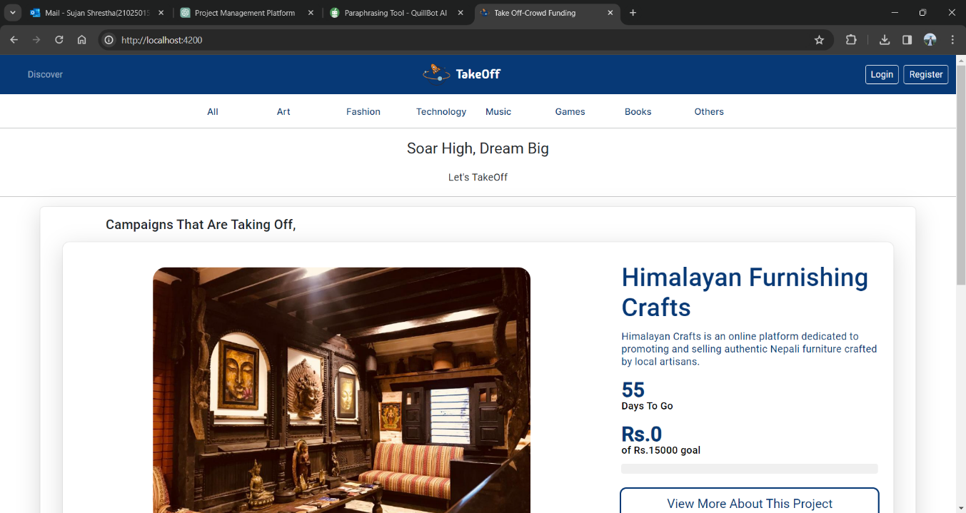
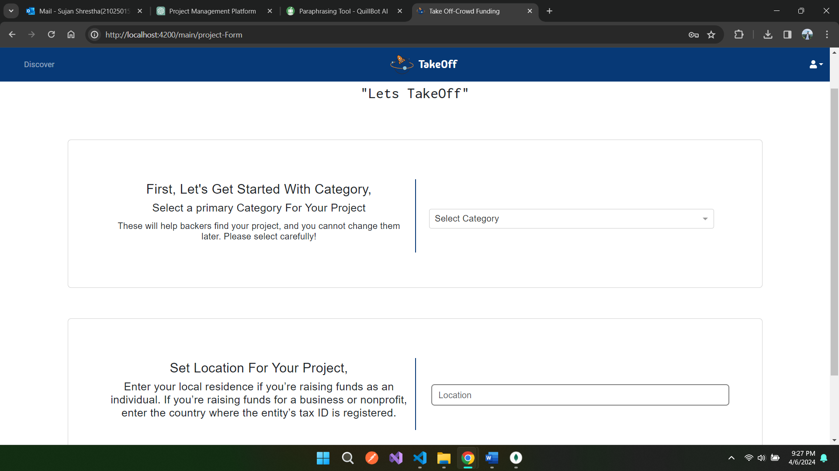
System implementation
Home Page
Project Creation Form

Slide 13
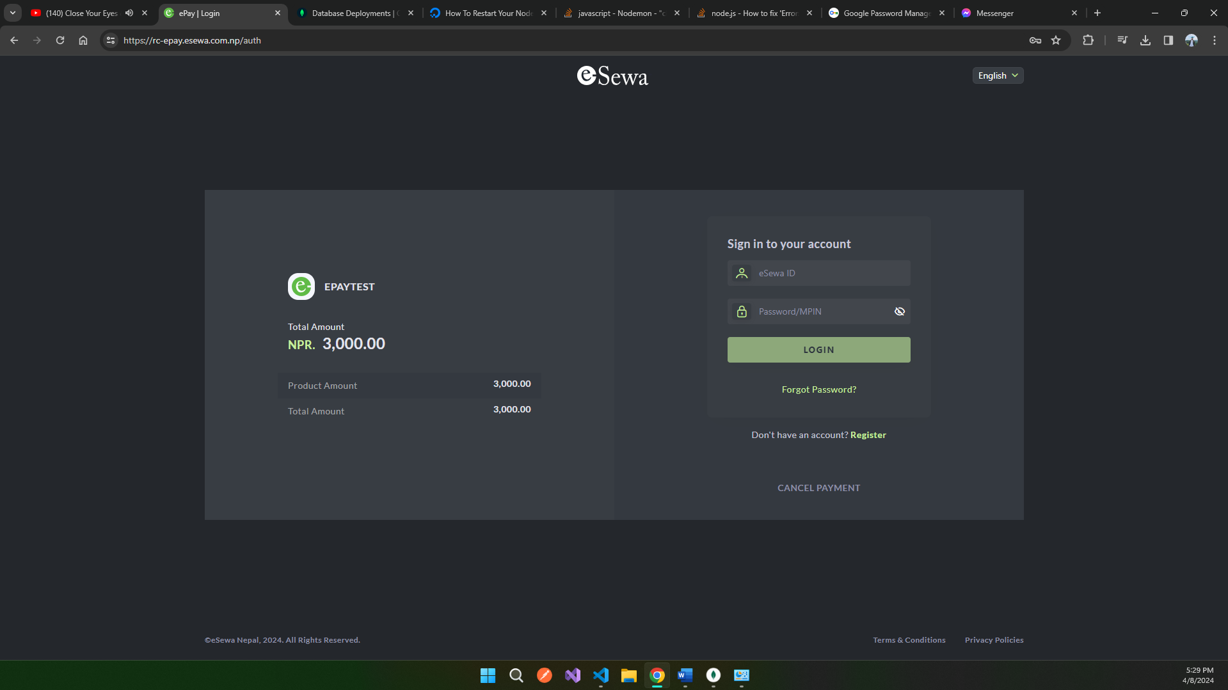
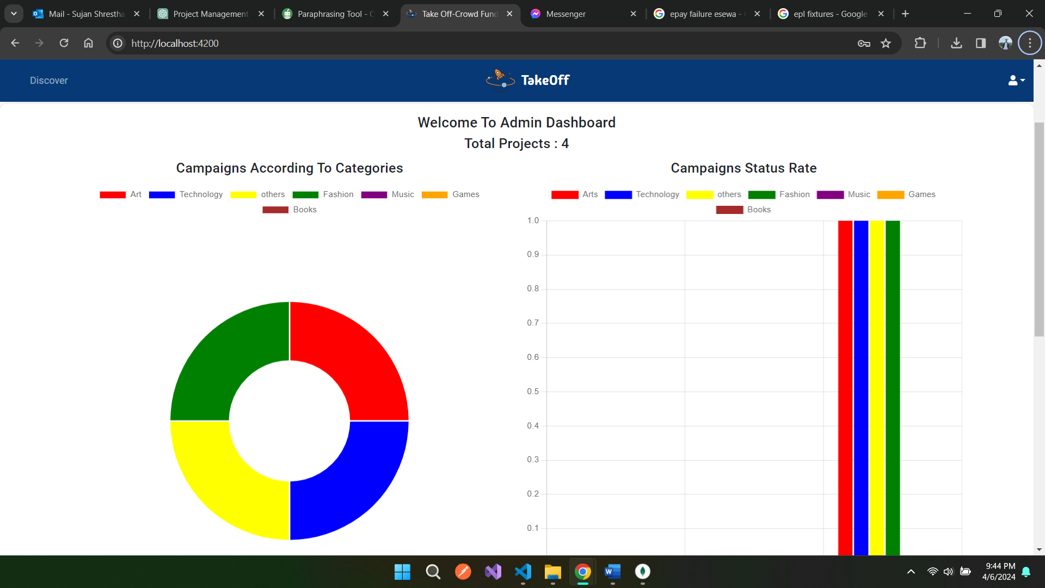
System implementation
Esewa V2 API Integration
Project Analytics

Slide 14
Testing (Unit Testing)
Test Case | Description | Test Steps | Expected Results
Login/Registration | Verify that user can successfully login and register into the system | Provide valid user details such as name, email, and password. Submit the details to the System | In the registration part, User profile should be created successfully and will be redirected to Login page after Verification. In login part, the user will be redirected to respective user dashboard
Project Creation | Ensure that a creator can create a project with all required information | Provide valid project details including title, description, goal amount and other form data. Upload proper media files as required. Submit the project details to the system. | Project is created successfully, and the project should be visible on the platform for investors to view them

Slide 15
Testing (Unit Testing)
Test Case | Description | Test Steps | Expected Results
Investment in Project | Test whether investor can pledge towards a project | Browse Available Projects. Select a project of interest. Choose a pledge amount and click on invest. Connect investor’s esewa account with our esewa API. | Pledge is recorded successfully, and the investor receives confirmation of their contribution
Campaign Duration Setting | Test whether creators can set the duration of their fundraising campaigns. | Create a new project. Set specific data as an end date for their project | Campaign duration is set as per the creator’s specifications, and the project remains active for defined period.

Slide 16
Testing (Unit Testing)
Test Case | Description | Test Steps | Expected Results
Project Analytics Tracking for Admin | Ensure that project analytics accurately track categories which are being invested in highly. | Monitor project analytics dashboard. Verify that funding progress, investor engagement, and other metrics are updated in real time. | Project analytics should provide accurate and up to date information for administrators.
Transaction Handling | Test the measures implemented for financial transactions via Esewa. | Initiate Financial Transaction Verify the hashing process and secure payment is completed. | Financial transactions via Esewa are conducted securely without exposing sensitive information

Slide 17
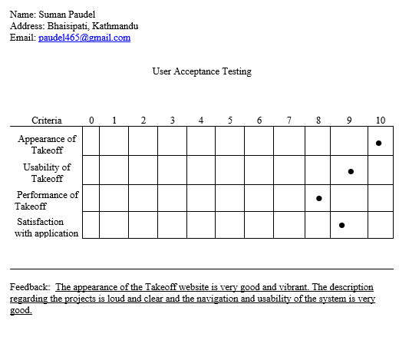
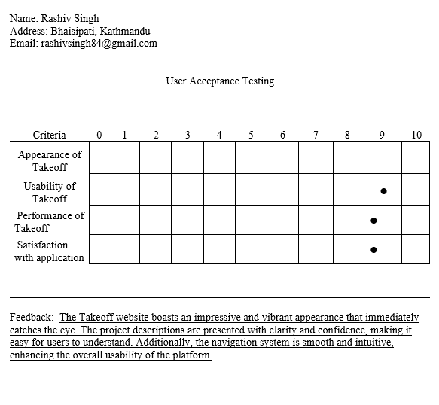
Testing (UAT)

Slide 18
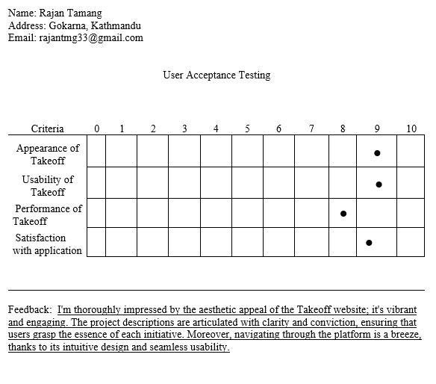
Testing (UAT)

Slide 19
Problems and Limitations
Regulatory and Compliance Issues
Financial Regulation Compliance: Navigating the complexities of local financial regulations and legal
requirements for online crowdfunding.
Data Privacy Concerns: Ensuring full compliance with data protection regulations and safeguarding user privacy.
Market and Adoption Limitations
Low Market Awareness: Limited awareness and understanding of the platform's benefits among potential users.
Development and Maintenance Problems
Resource Constraints: Limited development resources and challenges in managing them effectively.
Continuous Improvement Barriers: Difficulties in regularly updating the platform based on user feedback and technological advancements.

Slide 20
Future enhancements
Support for Group and Organization Campaigns
Multi-Creator Functionality: Enable the platform to handle campaigns created by groups or organizations, not just solo creators.
Collaborative Campaign Management: Introduce features allowing multiple users to manage a single campaign collaboratively.
Enhanced User Experience
Advanced UI/UX Design: Implement more intuitive and interactive design elements to improve user navigation and engagement.
Personalized Recommendations: Use machine learning to offer personalized campaign recommendations to users based on their interests and behaviour.
Expanded Payment Options
Multiple Payment Gateways: Integrate additional payment gateways beyond eSewa to offer users more payment options.
Cryptocurrency Support: Explore the possibility of accepting cryptocurrencies as a payment method.
Enhanced Campaign Validation
AI-Powered Fraud Detection: Utilize artificial intelligence to detect and prevent fraudulent campaigns more effectively.
Detailed Verification Processes: Implement more thorough campaign verification procedures to ensure legitimacy.

Slide 21
conclusion
Through this project, my programming skills have significantly improved, particularly with the MERN stack (MongoDB, Express.js, React, Node.js). I have developed a stronger ability to solve complex problems, especially those related to integrating various APIs and managing system architecture. Additionally, my time management skills have seen considerable enhancement. I have learned to allocate time efficiently across different phases of the project, including research, development, testing, and documentation. This has enabled me to meet deadlines and manage project milestones effectively. Furthermore, my documentation skills have strengthened. I have become proficient in creating comprehensive project documentation, allowing me to clearly articulate technical details and project progress. Overall, this project has contributed greatly to my personal and professional growth.

Slide 22
Any Queries? Thank you

